Slide 1
Docker Certified Associate Training
Source: https://docs.docker.com
Notes:
Mention the course name

Slide 2
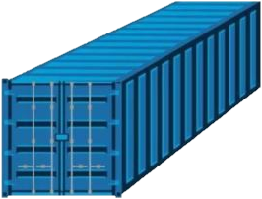

What Is Docker?
Application A
Application B
Docker
Application C
Notes:
Audio file: .mp3
Time stamp:
Audio script:
So, what is Docker? Docker is a set of various types of tools and products that deliver software applications in packages called containers.
Let us take a look at Docker from a developer’s point of view.
Media instructions to GD: (use level 3 animation, change color)
So, (GD:Show text in bold on screen when the trainer mentions it) what is Docker? (GD:Show the icon and text on screen when the trainer mentions the text in bold) Docker is a set of various types of tools and products that deliver(GD:Show all arrows and application A, application B, Application C whent trainer mentions software applications) software applications in packages called (GD: show all arrows and containers when trainer mentions the text in bold) containers.
Let us take a look at Docker (GD:move to next slide and keep this entire sentence in audio) from a developer’s point of view.

Slide 3



What Is Docker?
Application A
Docker
Application A
Application B
Docker
Application C
Notes:
First flow→ Docker provides a platform to build and deploy new applications.
2nd Flow→All this is done using isolated bundles for application development, making the application more secure and portable. Now, let us understand how Docker adds value to the development.
Now, let us understand how Docker adds value to the development.

Slide 4
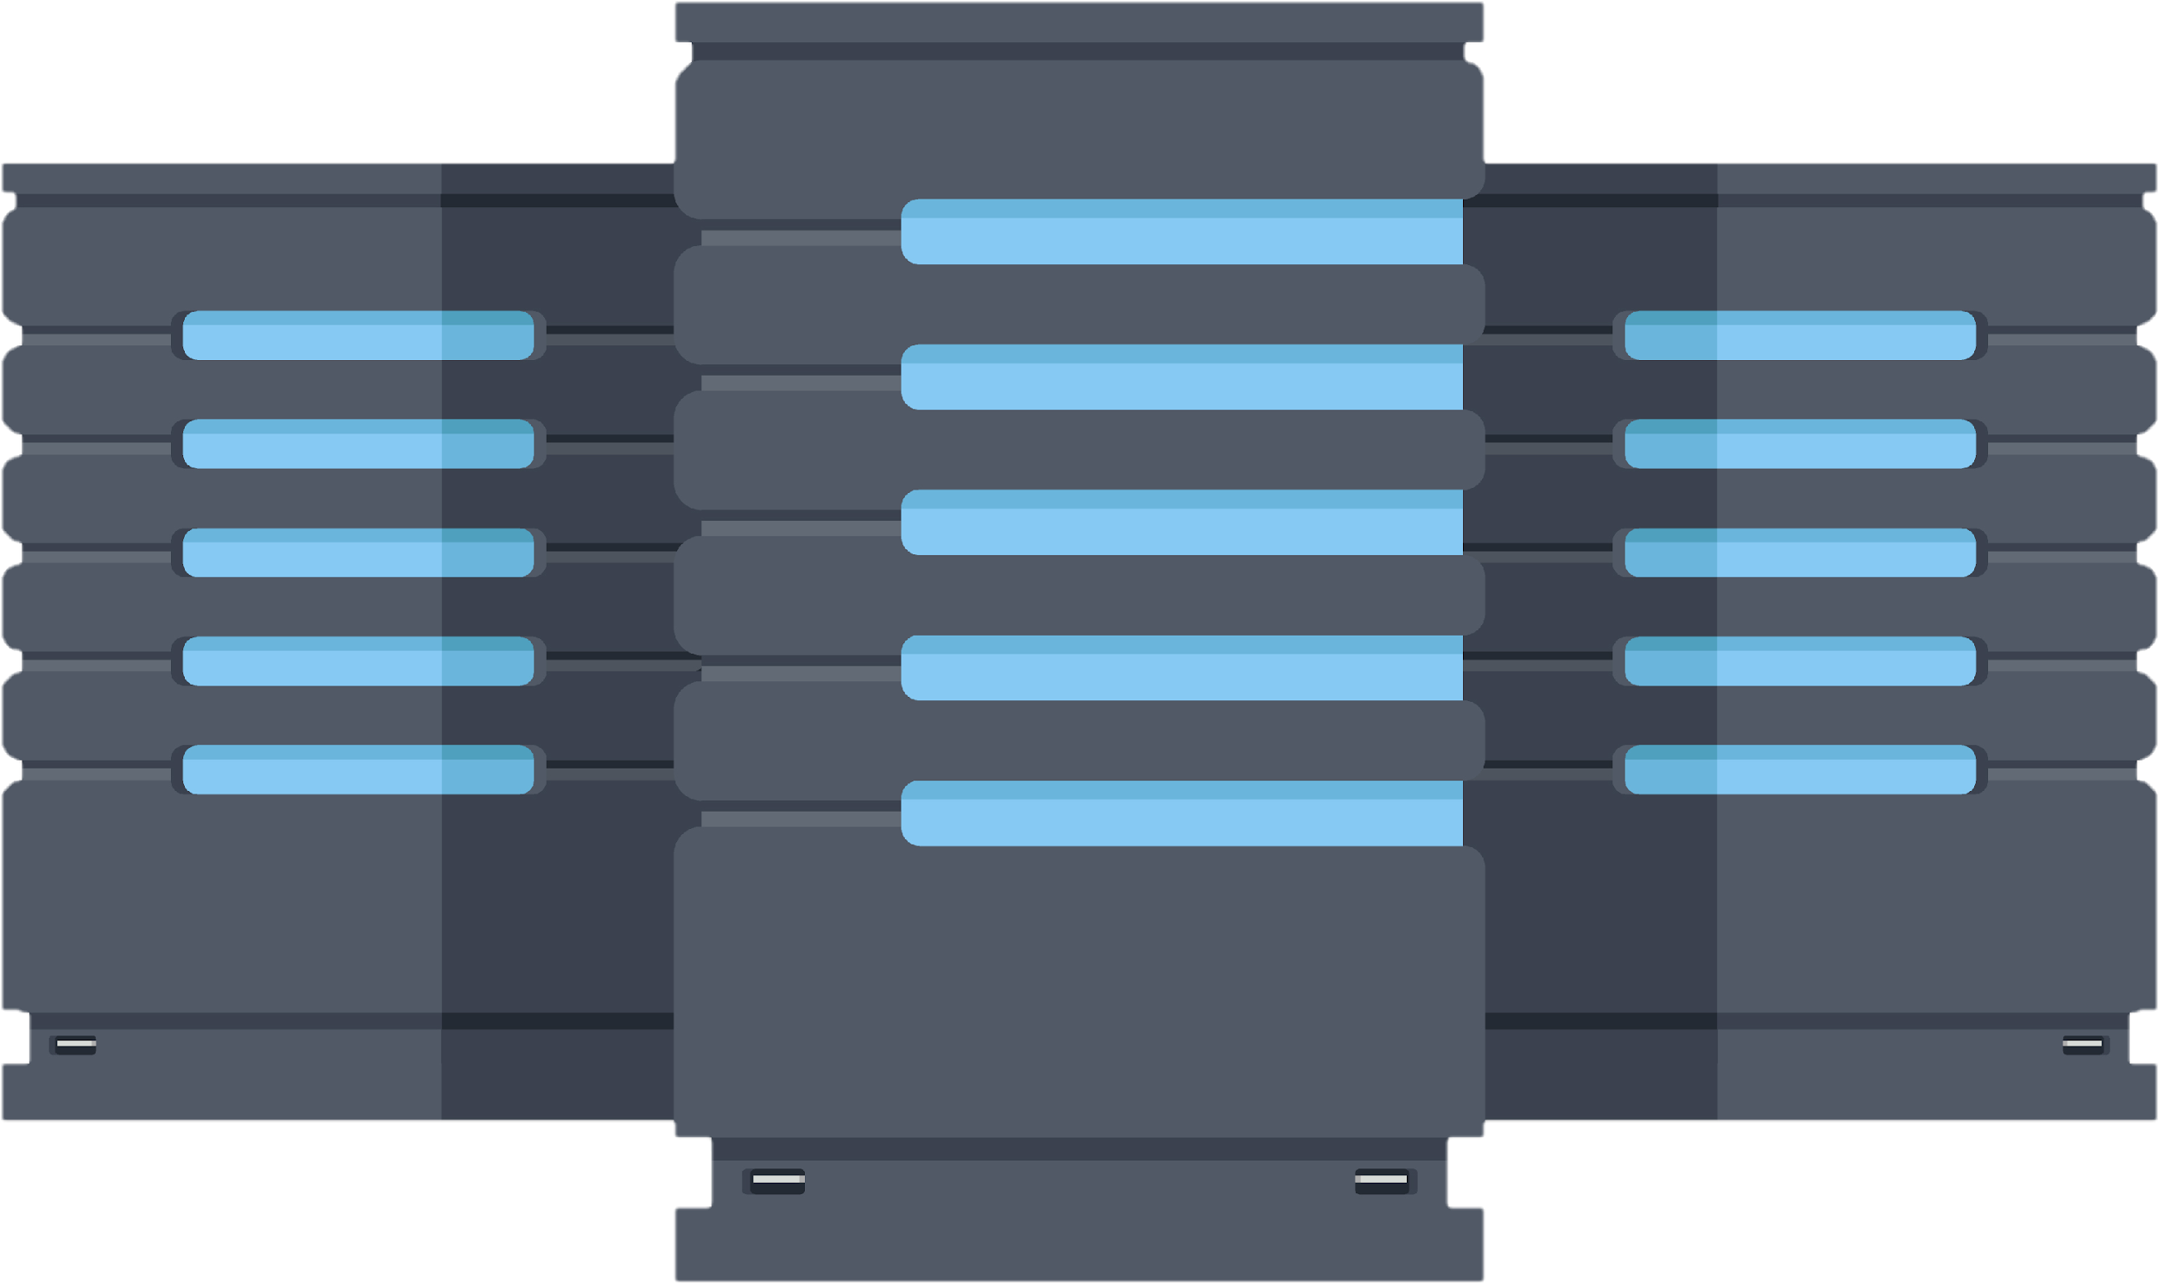
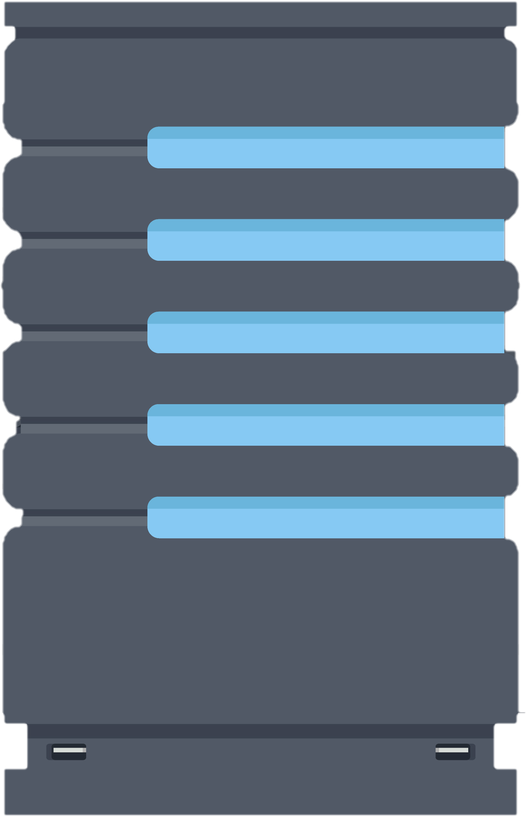



Features of Docker
Application isolation and security management
Rapid deployment
Multitenancy
Server consolidation
Simplified configuration
Increased productivity
Notes:
Let us begin by discussing the major features of Docker.
Simplified Configuration: Docker helps deploy codes with less time and effort. This is because the infrastructure requirements are no longer linked with the environment of the application.
Multi-tenancy: The latest release of Docker EE introduces a new resource control model that allows organizations to define resource collections granted to specific users, teams or organizations.
Application Isolation and security management: Docker provides containers that are independent of each other and it allows the execution of any kind of application.
Rapid deployment: The incoming requests are routed for published ports on all available nodes. This feature enables the connection, even if there is no task running on the node.
Server consolidation: Containerized applications share common operating systems and software libraries that greatly improve CPU utilization within a Virtual Machine. This helps organizations reduce the number of virtual machines required to operate their environment. This also increases the number of applications that can run on a server.
Security: Apart from isolation feature, Docker also saves secrets in the swarm and allows certain secrets to access services.
Let us understand what sets Docker apart from a similar technology called Virtual machines.

Slide 5
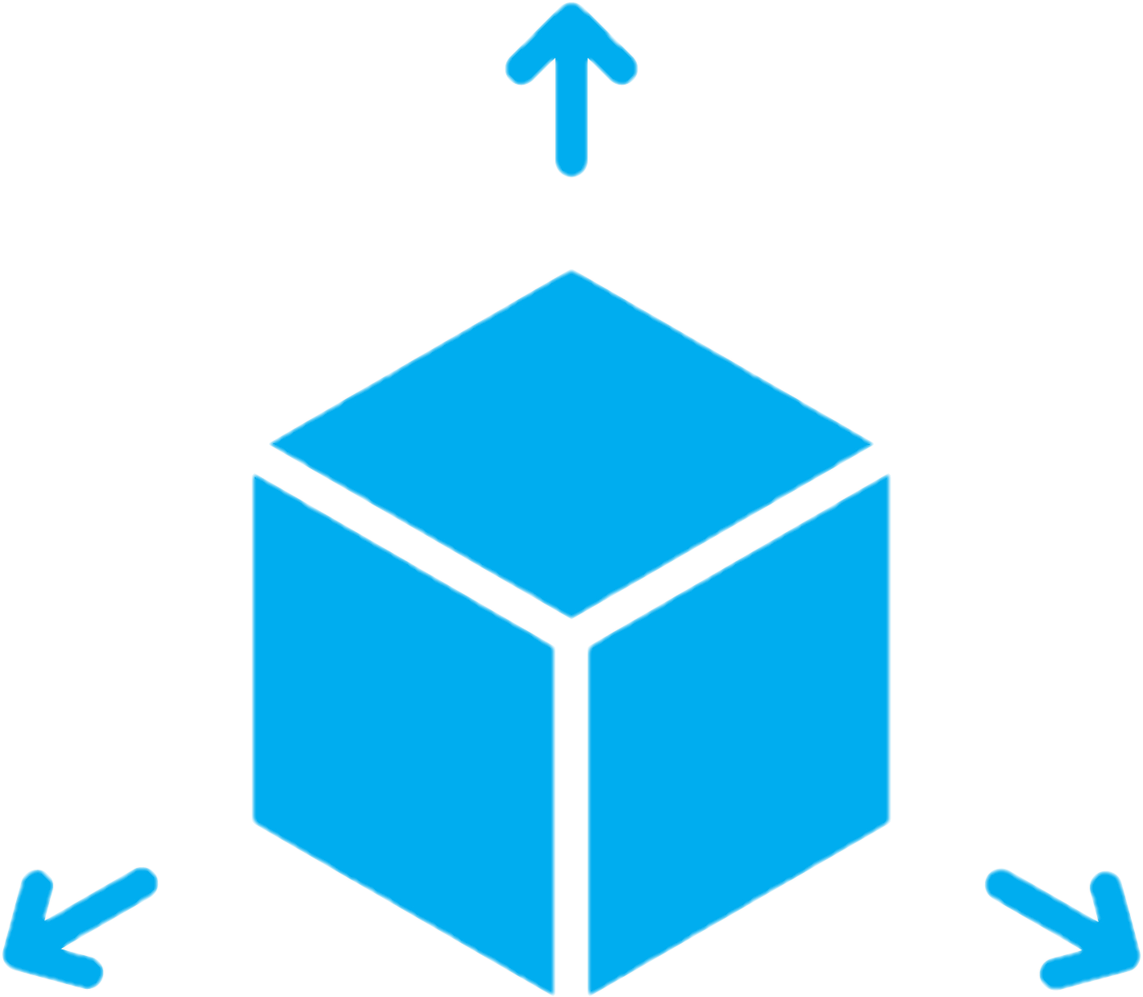
Virtual Machine vs. Docker
Separate OS for each VM
Host OS is shared by all the containers
Virtualization is hardware-level based
Virtualization is OS based
Startup takes a few minutes
Startup takes a few milliseconds
Notes:
Although there are many differences between Virtual Machines and containers, we are going to discuss only the important ones:
In Virtual Machine, each VM runs in its own Operating System, whereas all containers share the host Operating System.
Virtual Machines have Hardware-level virtualization and Docker has OS virtualization.
Virtual Machines take a few minutes to boot and be dev-ready, whereas Docker is very fast and take milliseconds to become dev-ready.

Slide 6




Industries Using Docker
Healthcare
Information Technology
Industries
Finance
Software
Telecommunications
Notes:
Docker is currently used in various industries. We will look at a few important ones, such as:
Computer software, information technology, healthcare, financial services, and telecommunication.
Transition line: Let us gain an understanding about Docker certification and criteria.

Slide 7




Exam Information
Exam
55 Multiple choice questions
90 minutes
English
Notes:
The Docker Certified Associate exam will have 55 multiple choice questions and the time allotted will be 90 minutes. This exam is globally available in English.

Slide 8

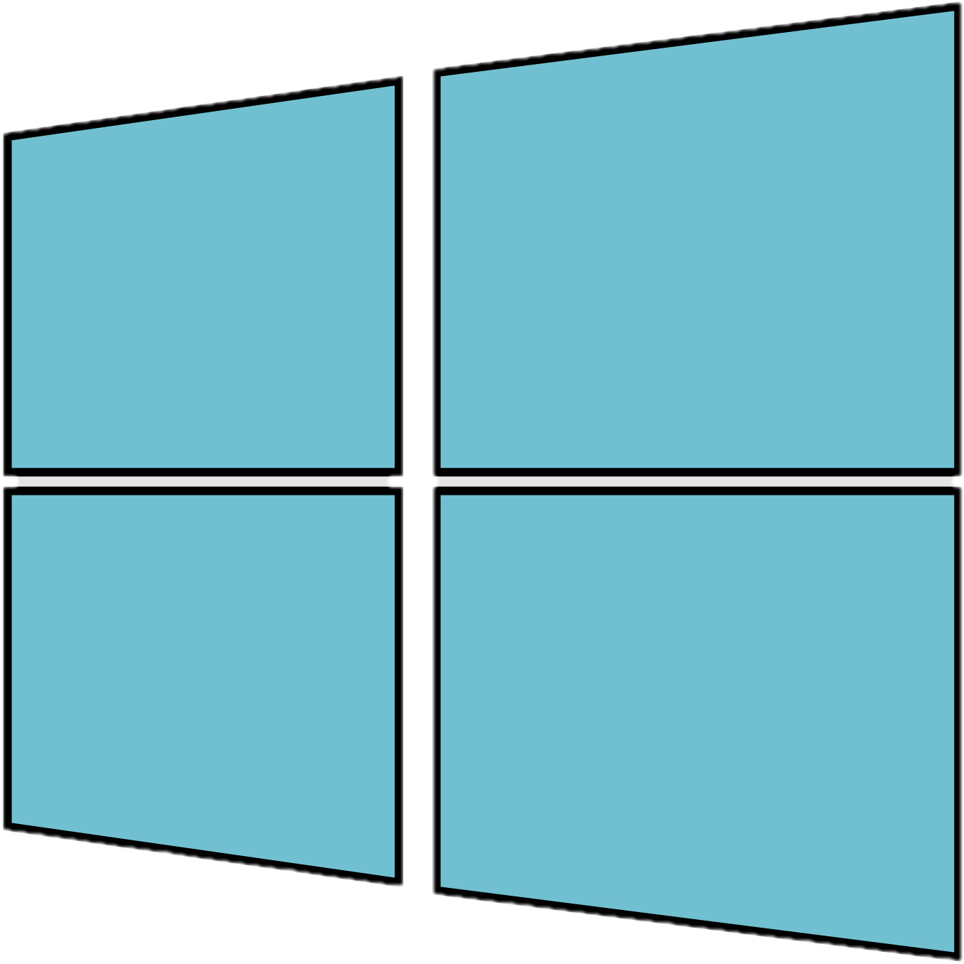

Exam Information
Exam
Proctored exam
Microsoft Windows
Notes:
This exam is remotely proctored on Windows or Mac.

Slide 9



Exam Information
Microsoft Windows
Google Chrome
Exam
Tools
Web camera
Notes:
and all the required equipment is provided:
A current version of Microsoft Windows or Mac OS X.
A Google Chrome web browser and the ability to install a Chrome extension.
A web camera accessible by Google Chrome.

Slide 10


Exam Information
Exam
USD 195
Euro 175
One attempt
Note: Candidates who wish to cancel or reschedule the exam, must do so 48 hours before the scheduled appointment time. Else, the exam fee will be forfeited.
Notes:
The exam fee is 195 US dollars or 175 Euro and the exam can be attempted only once.
Candidates who wish to cancel or reschedule the exam, must do it 48 hours before the scheduled appointment time. Else, the exam fee will be forfeited.

Slide 11



Exam Information
Exam
Result
Certificate is accessible in 48 hours
2 years
Notes:
Results of the exam are delivered immediately. The candidate will receive an email within 48 hours after taking the exam. If eligible, the candidate can access the certificate from this email. The certification is valid for 2 years and candidates are required to update the certification every two years.
Let us understand the examination format of Docker Certified Associate exam.

Slide 12
Examination Weighting
Lessons | Weighting
Orchestration | 25%
Image Creation, Management, and Registry | 20%
Installation and Configuration | 15%
Networking | 15%
Security | 15%
Storage and Volumes | 10%
Notes:
This exam is primarily focussed on these six lessons. The first lesson ,i.e., Orchestration carries a weightage of 25%.
Lesson 2 - Image Creation, Management, and Registry weighs 20%. Lessons Installation and configuration, networking, and security weigh 15% each.
The last lesson Storage and volumes carries the weightage of 10%

Slide 13
Question Formats
Multiple response questions
Multiple choice questions
Sample direction questions
Notes:
The Docker Certified Associate exam will have questions presented in these formats:
Multiple choice where the candidate selects one option that best answers the question or completes a statement.
Multiple response where The candidate selects more than one option that answers the question.
Sample Direction Questions: Here, Candidates must read the statement or question and select the option or options that represent the correct answer given the information.
Now, let us discuss what Simplilearn is offering in this course.

Slide 14
Course Outline
Seven domains
One pre-read
Notes:
The Docker Certification Training course offered by Simplilearn will have 7 domains and 1 pre-read that will discuss Docker in the DevOps life cycle.

Slide 15
Course Outline
Introduction to Docker
1
2
Image Creation, Management, and Registry
Networking
3
4
Orchestration
Installation and Configuration of Docker Enterprise
5
6
Security
Notes:
The six domains covered in this course are:
Introduction to Docker
Image Creation, Management, and Registry Networking
Orchestration
Installation and configuration
Security

Slide 16
Course Outcome
Dockerfile
Docker objects
Registry
Concepts
Notes:
After completing this course, candidates will be able to:
Comprehend the concepts of Docker objects, Dockerfile, and Registry

Slide 17
Course Outcome
Swarm draining
Quorum
Compose tool
Swarm
Networks and volumes
Concepts
Notes:
Candidates will also learn the concepts of Swarm, Quorum, Swarm draining, Compose tool, and learn about Networks and volume

Slide 18
Course Outcome
Grant
UCP
DTR
Docker EE
High availability and load balancing
Usage
Notes:
The usage of Docker EE, UCP, Grant and its components DTR, high availability and load balancing in UCP/DTR will be discussed in detail.

Slide 19
Course Outcome
Signing an image
Docker Content Trust Verification
Security
UCP client bundle
Integration of UCP with LDAP
Notes:
The concepts of Docker Security, such as the importance of signing an image, Docker Content Trust verification, UCP client bundle, and the integration of UCP with LDAP will also be discussed in this course.

Slide 20
Course Outcome
Volumes
Storage drivers
Concepts
Logging drivers
UCP/DTR/Swarm Backup
Notes:
Finally, the learners will also be able to comprehend the concepts of Volumes, Storage drivers, Logging drivers, and UCP/DTR/Swarm Backup.
So, what other components does SimpliLearn offer?

Slide 21






Course Components
Instructor-Led
Training
49 Assisted and Unassisted Practices
7 Knowledge Checks
3 Lesson-End Projects
1 Course-End Project
2 Course-End
Assessments
Notes:
The Docker Certification Training course include: Instructor led training
49 Assisted and unassisted practices
7 knowledge checks
3 Lesson-end projects
1 Course-end project
2 course-end assessments

Slide 22

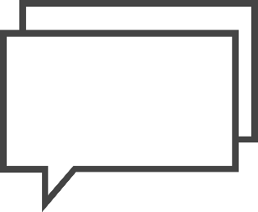
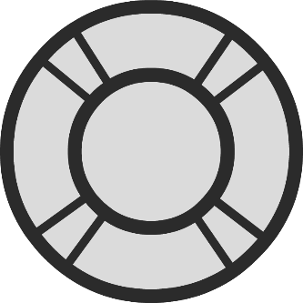
Customer Support
Teaching assistant support
Help and support on the website
Call and live chat
Notes:
In case of queries and issues, candidates can reach us through:
Teaching assistant support.
Support on website
Call and live chat

Slide 23

Notes:
Lets begin

